Slide 1
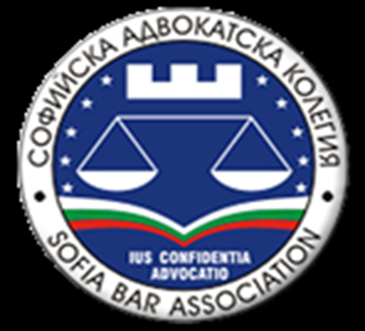
DEVELOPING AND STRENGHTENING THE SOCIAL ROLE of the Modern Bar Association Through Cooperation with Other Legal Entities
SOFIA BAR ASSOCIATION
ELKA POROMINSKA
YORDANKA BEKIRSKA
WARSAW,
MODERN BAR ASSOCIATION CONFERENCE
13 – 14 JUNE 2019

Slide 2
Sofia bar association 120 years of history
Established in1897;
The first law for lawyers was created on 22nd of November 1888;
The Sofia Bar Council was established on 11th of October 1889;
over 6000 lawyers are
members of Sofia Bar
Association in 2019;

Slide 3
Constitution of the Republic of Bulgaria
According to Art. 134 of the Constitution of the Republic of Bulgaria:
"para. 1. The Bar is free, independent and self-governing. It assists citizens and legal entities in the protection of their rights and legitimate interests;
para. 2. The organization and the order of the activity of the Bar shall be regulated by law. "

Slide 4
BULGARIAN BAR ASSOCIATIONS
Supreme Bar Council
Over 14 000 attorneys-of-law in Bulgaria in 2019
27 bar associations, based on a territorial basis – independent legal entities created under the Attorney Act

Slide 5
Collaboration with legal entities
The Women Lawyers Association (WLA), founded in July 2014, which has been active for 5 years;
Francophone Attorneys' Club;
Club of Russian-speaking lawyers;
Club of Spanish-speaking lawyers;
Junior Lawyers Association;
Organizations of Bulgarian mediators /involving lawyers/;
Bulgarian Lawyers for Human Rights.

Slide 6
Social role of the sofia bar association
Involvement of NGOs in drafting and discussing bills directly addressing social issues to society;
Participation of representatives of lawyers NGOs in the work of the Legal Commission in the National Assembly – the Bulgarian Parlament that is the supreme legislative body;
Participation in the work of the team of the National Ombudsman of the Republic of Bulgaria;
Submitting expert statements before the
Constitutional Court of the Republic of
Bulgaria in raising questions about the
constitutionality of certain legal norms and laws.

Slide 7
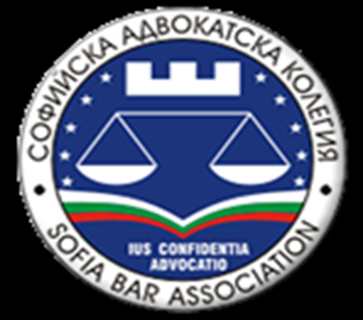
Sofia Bar Association and Women Lawyers Association
"The Institutions, the Media and the Public Together Against Violence Against Women", in connection with the signing and ratification of the "Council of Europe Convention on the Prevention and Combating of Violence against Women and Domestic Violence" -called the "Istanbul Convention" by the Republic of Bulgaria.
Collaboration between Women Lawyers Association, the Association of Women Lawyers - Milano, the Sofia Bar Association,
the Milan Bar Association and the
Supreme Bar Council.

Slide 8
Sofia Bar Association and Women Lawyers Association
E-Justice Conference "Bulgaria - Opportunities and Challenges. Italy - Realization and Experience “
the International Conference ON FAITH‘S COMMAND AND CIVIL FREEDOMS DEMAND: The Role of the Bulgarian Orthodox Church in Saving the Bulgarian Jews. The Contribution of the Bulgarian Lawyers to the Protection of the Highest Value – Human Life in the Saving of the Bulgarian Jews“

Slide 9
Domestic violence and the role of lawyers and legal entities
The International Forum "Lawyers Against Violence" was held in Plovdiv on November 2018. It was organized by the Women Lawyers Association, the Association of Women Lawyers Milano, Sofia Bar Association and the Supreme Bar Council. Representatives of the Bulgarian Parliament and the Ministry of Justice took part in the forum.

Slide 10
Collaboration with other legal enthities
"Ethical rules of the professions of the judge, the lawyer and the prosecutor - a guarantee for a fair trial".
This type of cooperation strongly supports lawyers in the implementation and protection of their rights and creates uniform standards for the exercise of the profession and indirectly affects the rights of citizens.
The conference was organized by the Sofia Bar Association, the Supreme Bar Council, the International Bar Association with a common legal tradition, with the participation of the Paris Bar Association, the Association of Presidents of the Supreme Courts of the Francophone States and the Francophone Attorneys' Club.

Slide 11
RiGHT OF CONSTITUTIONAL COMPLAINT
Supreme Bar Council as a representative of the Bulgarian Bar Association to be able to file constitutional complaints about the unconstitutionality of laws that affect the rights and freedoms of the citizens. (Article 150 of the Constitution, the Official State Gazette- issue 100/2015). The Supreme Bar Council may be alerted by any citizen and, upon judgment and decision of the Supreme Bar Council, a complaint is lodged with The Constitutional Court of the Republic of Bulgaria. This leads to an increase in the social role of the Bar Association and to bringing it closer to the interests of citizens, whose rights and freedoms can be protected in a completely new way.

Slide 12
BENEFITS FOR THE INDIVIDUAL LAWYER
The joint work between bar associations and other legal entities created by lawyers, as well as scientific institutions, has led to the broadening of the protection of both the interests of the Bar and the individual lawyer, the citizens and society as a whole.

Slide 13
Elka porominska yordanka bekirska WARSAW, MODERN BAR ASSOCIATION CONFERENCE 13 – 14 JUNE 2019
THANK YOU FOR YOUR ATTENTION!
YOUR QUESTIONS ARE WELCOME!

