Slide 1
Independence of the Bar at Stake?
Peter Hanenberg
Dean of the Rotterdam Bar Associaton

Slide 2
Historic Situation; Low countries 16th Century

Slide 3
Situation in 16th and 17th century (Republic)
Towns and regions had their own courts and system of justice
Lawyers were officers of the court
Supervision and regulation was provided by the courts
No (independend) Bar Asscocation at all, not even locally organized

Slide 4
French influence early 19th century
New court system, over 100 small claims courts (Justice of the Peace), 19 district courts, 5 courts of appeal and one supreme court
Lawyers organized locally in Bar Associations
Supervision and control by the prosecutor
No freedom to organize meetings and no free elections of members of the board of the Bar Associations

Slide 5
Rights and Obligations of lawyers today
Main characteristics;
Academic law degree
Admitted to the Bar and thus brought under disciplinary law (by oath)
Under supervision of the Dean of the local bar
Entitled to represent clients at district courts and courts of appeal
Duty of confidentiality
Legal advisors aren’t lawyers; there is no separate Bar Association and no conditions to practice as legal advisor!

Slide 6
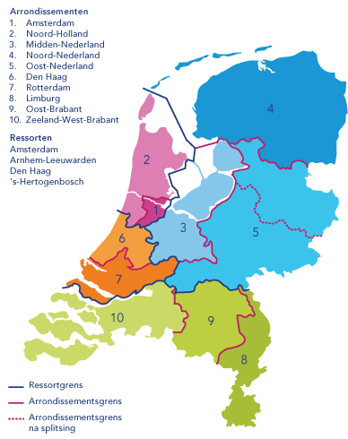
Today’s 11 Districts

Slide 7
Membership of National and Local Bar

Slide 8
Democratic Representation

Slide 9
Situation today
11 local bar associations
Elected members of the council including the president (dean)
Dean is chair of te council but also supervisor and regulator
One national bar of which all lawyers are also members.
General council and national dean are elected by delegates from the local bars
Netherlands Bar Association itself has no role in supervision
Netherlands Bar Association issues bye law which binds all lawyers on topics such as permanent education, client monies, organization of firms, insurance etc.
5 Disciplinary Courts and one Court of Appeal
Chaired by 1 professional judge, 2 or 4 members from the profession
Appeal: 3 professional judges and 4 members from the profession

Slide 10
Local Bar Associations
Summary;
All members choose the members of the council and president for certain periods
Tasks of the council;
Admittance to the bar
Supervision of lawyers acting as principal
Monitoring trainees during 3 years of training
Certification of trainees after 3-year period
Stimulating Best Practices and Permanent education of all lawyers
Deciding on requests to practice law (temporarily) outside the district
Assistance of the Dean in his supervising tasks

Slide 11
Netherlands Bar Association
Summary;
Each lawyer is als member of the national bar
Local Bar Associations elect representatives who can elect members of the General Council and General Dean
Netherlands Bar Association is responsible for the general management and can issue Bye laws and Regulations (Such as education of trainees and permanent education)
Body of administrative appeal
The Netherlands Bar Association has no direct control of the local bars and individual members!
Regulation and supervision are basicly in the hands of the local Dean alone
The General Dean has no direct authority over the local Deans; he needs the advise from the Supervisory Board
The Supervisory Board has two members appointed by the Crown – they are no lawyers. Chair of the Supervisory Board is the General Dean

Slide 12
Tasks of the Dean (Local Bar)
President of meetings of the council and local general assembly
Supervision of individual lawyers
Dealing with complaints
Advising lawyers in conflicts or several matters prescribed in the law of Code of Conduct
Regulation and supervision in financial matters (EU directive on Anti-money laundering and counter terrorist financing)

Slide 13
System of Supervision
Supervisory Board
(President of National bar + two members appointed by the crown)
Local Bar Presidents' Consultative Panel
Local President
Local President
Local President

Slide 14
Today’s challenges
Limitation of the duty if confidentiallity
(due to the urge to fight criminality)
External control or supervision of lawyers
(due to the fear of protecting fellow professionals)
Incorporating limitations in the defence for ‘the common good’
(due to the wish to control proceedings)

